Slide 1
POOJA RAJASEKARAN
Final Project
3/21/2024 Annual Review

Slide 2
PROJECT TITLE Disease diagnosis support system
3/21/2024 Annual Review

Slide 3


AGENDA
This is an overview of decision tree technique is used to classify the features of disease diagnosis Parameters such as age, gender, body pain, achieved are used in classification and the study achieved accuracy that correctly predicts the cause of disease. Here, the feature selection and also performed due to analysis.
Clearly define the primary objective of the system: to aid healthcare professionals in diagnosing diseases accurately and efficiently.
It also describe the sources and methods used to collect data for the system, including patient demographics, medical history, symptoms, and diagnostic outcomes.
3/21/2024 Annual Review

Slide 4

PROBLEM STATEMENT
In the realm of healthcare, timely and accurate diagnosis of diseases is crucial for effective treatment and patient management. However, the complexity and variability of symptoms across different diseases pose significant challenges to healthcare professionals. In this context, the development of intelligent systems capable of aiding in disease diagnosis becomes imperative.
The objective of this project is to design and implement a Disease Diagnosis Support System utilizing learning is a powerful machine learning technique. The system aims to assist healthcare professionals in making accurate and timely diagnoses based on patient symptoms and medical history.
3/21/2024 Annual Review

Slide 5

PROJECT OVERVIEW The overview of the project by highlighting the significance of accurate disease diagnosis in healthcare. Emphasize the need for intelligent decision support systems to aid healthcare professionals in diagnosing diseases effectively. Provide an overview of the project objectives and their methodology employed. It describe the challenges faced by healthcare professionals in disease diagnosis.
3/21/2024 Annual Review

Slide 6

WHO ARE THE END USERS
Healthcare Professionals: Doctors, nurses, and medical practitioners use the system for accurate diagnoses based on patient symptoms and history.
Medical Researchers: Researchers utilize the system to analyze disease patterns, aiding in discovering new diagnostic markers and refining existing criteria.
Healthcare Administrators: Administrators optimize resource allocation and healthcare delivery by monitoring disease trends and identifying areas for improvement.
Patients: Benefit from more accurate diagnoses and timely treatment recommendations facilitated by healthcare providers using the system.
Public Health Officials: Use the system to monitor disease outbreaks, identify at-risk populations, and implement preventive measures effectively.
3/21/2024 Annual Review

Slide 7

YOUR SOLUTION AND ITS VALUE PROPOSITION
Accuracy: Our system uses decision tree algorithms trained on medical data for highly accurate diagnostic suggestions, improving diagnoses compared to traditional methods.
Timeliness: Healthcare professionals quickly assess symptoms and receive rapid diagnostic suggestions, speeding up treatment and reducing wait times.
Interpretability: Transparent recommendations help healthcare professionals understand why they're given, fostering trust and collaboration for diagnosis refinement.
Efficiency: Automated symptom analysis and disease classification streamline workflows, letting healthcare professionals focus more on patient care.
Learning and Improvement: Continuous learning from feedback and updates ensures our system stays relevant and accurate over time.
3/21/2024 Annual Review

Slide 8

THE WOW IN YOUR SOLUTION
Smart Decision Making: Our system uses advanced algorithms to provide intelligent diagnostic recommendations. By analyzing patient data, it helps doctors make faster and more accurate diagnoses.
Instant Results: Doctors get quick diagnostic suggestions, speeding up treatment decisions and reducing patient wait times.
Personalized Recommendations: Tailored to each patient's unique characteristics, our system improves the relevance and accuracy of diagnoses.
Continuous Learning: Our system learns from feedback and stays updated with the latest medical knowledge, ensuring reliable recommendations.
Cost Savings: By minimizing errors and optimizing resources, our system saves money for healthcare providers while improving patient care.
3/21/2024 Annual Review
8

Slide 9
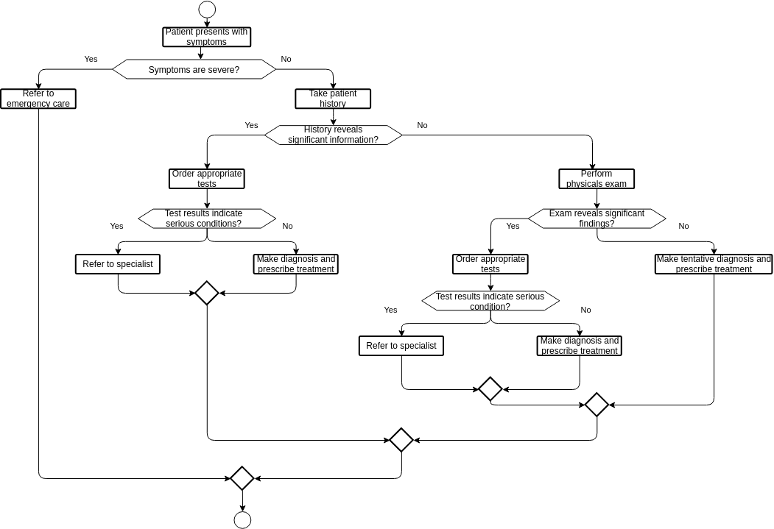
MODELLING
3/21/2024 Annual Review

Slide 10
RESULTS
Confusion Matrix: Summarizes true/false positives/negatives, guiding error analysis.
Feature Importance: Identifies crucial symptoms/patient traits for accurate diagnosis.
Interpretability: Ensures clear, trustworthy decision rules for healthcare professionals.
Clinical Validation: Real-world studies assess performance, usability, and impact.
User Feedback: Collecting insights from users enhances system refinement.
System Integration: Seamless integration and post-deployment monitoring ensure effectiveness.
Demo Link
3/21/2024 Annual Review
10

